Slide 1
HireRight Hackathon 2025 ->Supriyo Dey (Group 9) ->Neeraj Chandra (group 9)

Slide 2
Project: PDF ChatBot Powered by LLM
Features ::
📂 Upload a PDF: Select a PDF file to process.
🔍 Text Extraction & Indexing: Extracts content and indexes it for efficient search.
💡 Question-Answering: Ask questions related to the PDF content and get relevant answers.
🚀 Powered by Ollama & Phi3: Uses Microsoft Phi3 Model for embeddings and responses.
This project allows us to upload a PDF document and ask questions about its content. This uses Microsoft Phi3 Model via Ollama. The application processes PDFs, extracts text, indexes them, and retrieves relevant context to generate concise answers.

Slide 3
Use Cases ::
Can be trained with our existing internal documentations / process documents. This can act as point of reference for any process / product related query.
Department specific Modular Bots can be trained and integrated with existing messaging application.

Slide 4
Challenges :
Existing Process documents might require formatting to improve training quality of LLM and better inference.
Adequate testing required to ensure reliability.
Department specific segregation of database might be required to ensure unwanted access of data.

Slide 5
Project Prototype: https://github.com/supriyodey/HireRight_Hackathon25.git
Setup :
Clone the repository:
git clone https://github.com/supriyodey/HireRight_Hackathon25.git
Install dependencies:
pip install -r requirements.txt
Run the Streamlit app:
streamlit run pdf_rag.py
Prerequisites:
Python 3.8+
Ollama installed and running
Microsoft Phi3 model running
Dependencies installed via pip

Slide 6
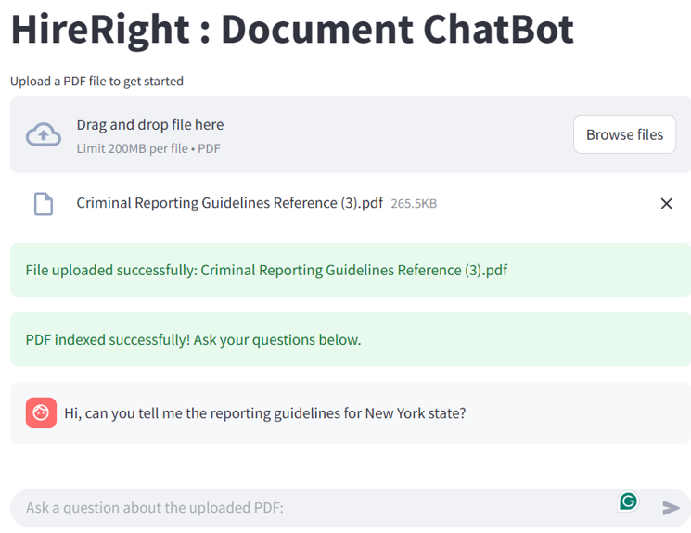
Test Results :
For testing, we used the Criminal Reporting Guidelines document
and asked the bot to explain the reporting guidelines for New York State.

Slide 7
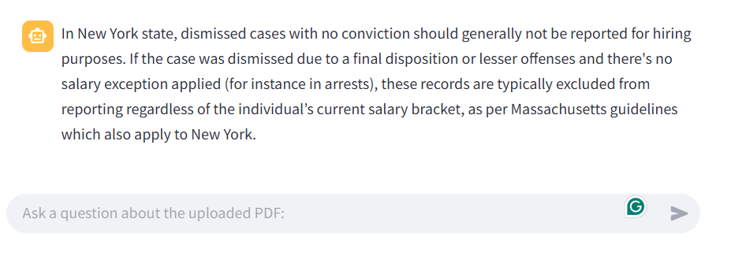
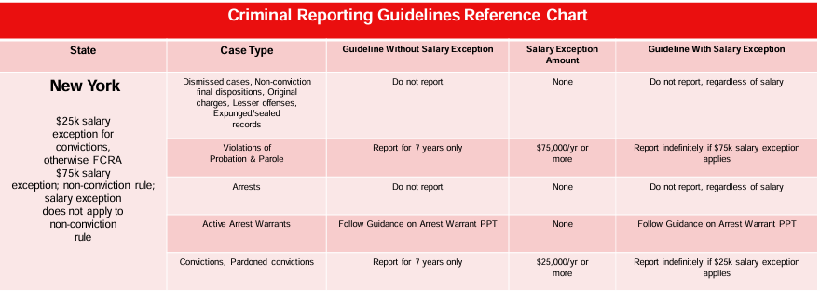
Response :
Comparing the response with the actual document, it did cover some of the guidelines, but a more accurate inference can be obtained by re-formatting the training document and training the bot in batches.

Slide 8
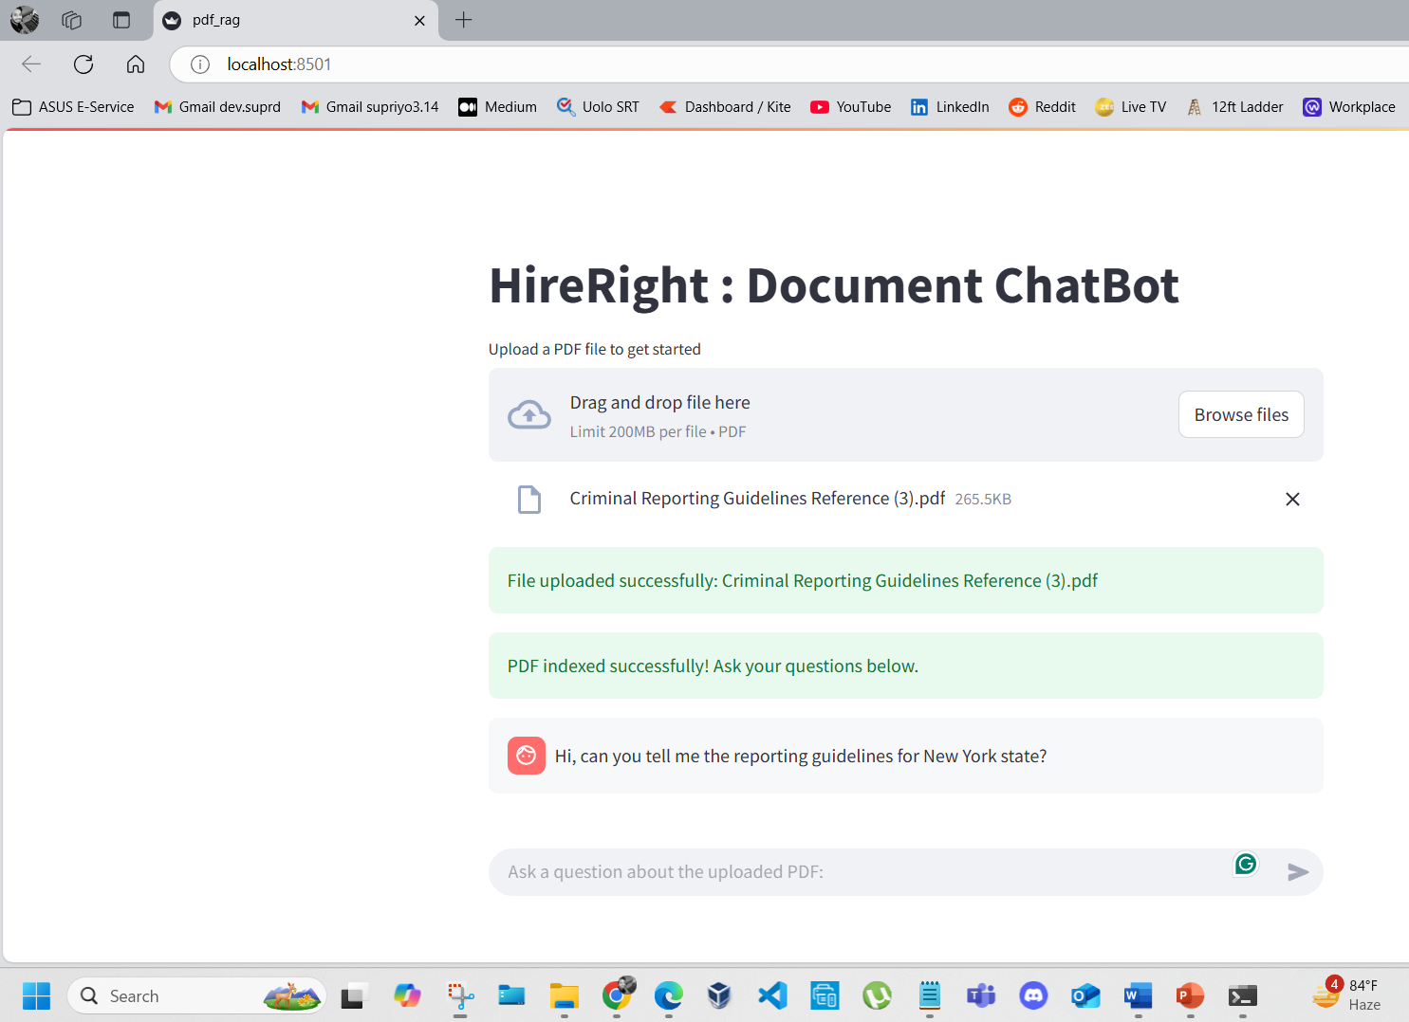
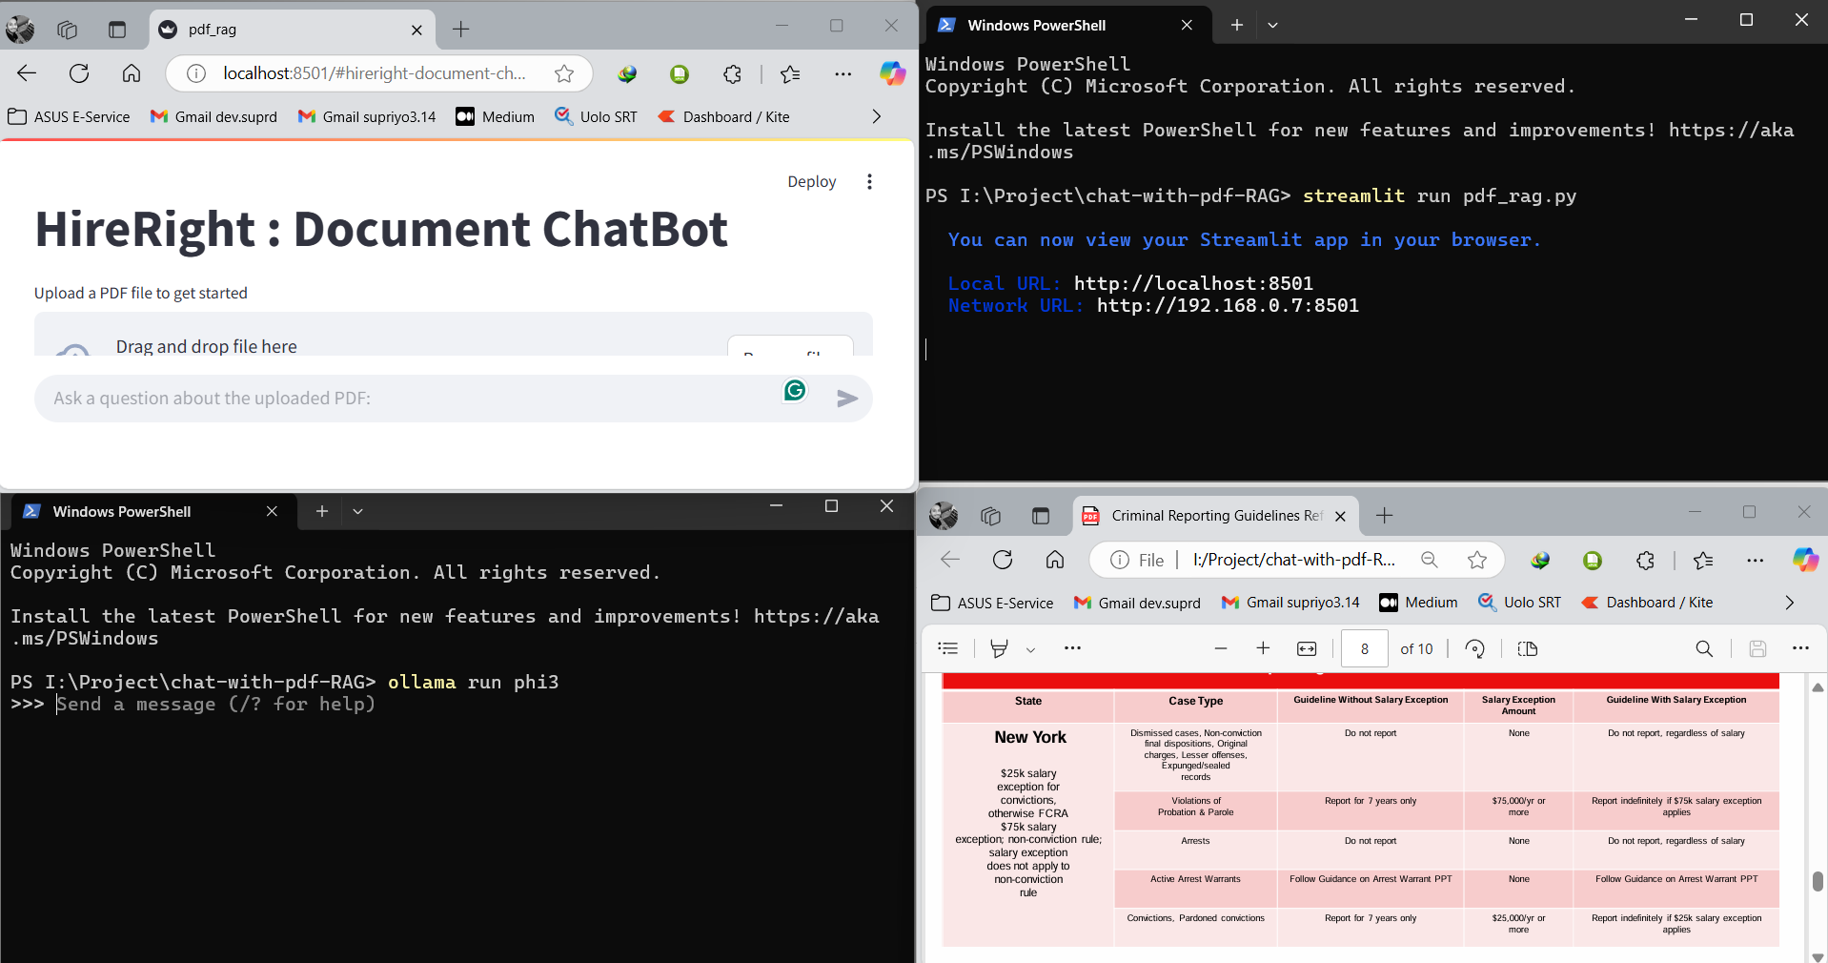
Screenshots ::

Slide 9
References Used ::
Medium Blogpost: https://medium.com/@pandeyarpit88/building-a-pdf-question-answering-system-with-ollama-and-langchain-5e851bdea447
Analytic Vidya Blog: https://www.analyticsvidhya.com/blog/2023/10/a-step-by-step-guide-to-pdf-chatbots-with-langchain-and-ollama/
Git Repo: https://github.com/jacoblee93/fully-local-pdf-chatbot
Reddit thread: https://www.reddit.com/r/ollama/comments/1dyffg8/has_anyone_have_a_good_tutorial_for_a_chatbot/

Slide 10
THANK YOU

